Slide 1
TOPICS COVERED
DDL
DML
WHERE clause(complete)
CONDITIONS
RETRIEVAL
FUNCTIONS
ALIASES
FETCH

Slide 2
DDL
CREATE TABLE, VIEW and INDEX
ALTER TABLE
DROP TABLE,VIEW AND INDEX
RENAME
TRUNCATE

Slide 3
General syntax for creating a table
  Create `table employee
  (empno char(4) not null primary key,
  Empname varchar(10) not null,
  Deptno char(4),
  Salary decimal(7,2) not null,
  Foreign key (deptno) references dept On delete CASCADE/SETNULL/RESTRICT)
  In dbmaple.tsmaple;
  Before specifying a FOREIGN KEY in employee table, DEPT table with deptno as primary key must exist with records.
Notes:
Now we know how to create a table with primary key and how to create index for that.
Now will see how to create a table with foreign key.
I think you people are familiar with foreign key( referential constrains) as we discussed in last class under the RDBMS concepts.
Before getting into the syntax will recollect the about foreign key.
Foreign key can refer only the primary key of another table.
There can be any one of foreign
Now will see an example for creating a table with foreign key.
In our example , Employee table contains the columns as empno, empname, deptno, salary. In this deptno is column which is referred to the column deptno of dept table.
So as same as previous example of create Dept. the query for employee as so written with specified columns. Then next to list of columns it should be followed by foreign key declarations which is followed by delete constrain.
In above syntax, FOREIGN KEY parameter specifies foreign key column that is deptno is foreign key column. Which is referred the base table dept by REFERENCES parameter.
ON DELETE is the parameter that specifies the delete constrain for this foreign key.
Ok now we created foreign key is created for a table.
Then now I leave a question to you.
Whether we should create any index table for this foreign key?
No, no need to created any index for foreign key. Because foreign key is nor for searching, its only for creating the relation between two tables.
Ok fine now u cleared with foreign key.

Slide 4
Create Unique Index
DDL
Create Unique Index inddept on dept(deptno)
Table will use that primary key as an search key while retrieval, so there should be an index for easy and fast searching.
Notes:
Index creation.
Why we need to create an index?
When we specify the primary key for a table, table will use that primary key as an search key while retrieval, so there should be an index for easy and fast searching. In DB2 then index for the primary key should be created only by the user.
Also when the table is specified as primary key, that table must contain the unique index for that primary key. Else that table can not access.
While the table is not contain any primary key, then index for that table is optional.
Syntax for creating the Index for a table is
Create Unique Index inddept on dept(deptno)
As create is the command for creating an object, Index is also a data object which to be created by CREATE statements.
CREAT

Slide 5
CREATE TABLE USING LIKE
DDL
A table can also be created with guidelines from a already existing table.
Primary and Foreign key definitions cannot be inherited.
The records of the table cannot be inherited.
Only the table structure( attributes and their Data types and length) will be nherited.
Syntax:
CREATE TABLE table name LIKE [Existing table] name.
Notes:
Well, now we know how to create a new table with our own specifications.
Next will see how to create a table with specification of existing table.
This can be done by like key word
That’s is
CREATE TABLE table name LIKE tablename
Using this syntax we can get only the structure of the table,
Foreign key, primary key, index and even data can not be inherited. These should be done separately using the alter statement.

Slide 6
ALTER Statements.
DDL
ALTER TABLE allows:
Addition of new columns to a table.
Addition and removal of Primary and foreign key specification.
ALTER TABLE does not allow :
  Change of data type
  Change column length
  Change NULL attribute
  Rearrange columns
  Remove a column
Notes:
Fine, you know how to create a table.
Now we will see how to alter the existing table.
Before knowing how to alter the table. Will see what are the alterations that can be done thro’ alter statements?
We can add new columns to the table
Primary key and foreign key can be added to the table.
Even we can remove the primary key and foreign key from existing table
Then what are all can not be done through Alter table?.
ALTER statement does not
change data type of a column.
change length of the column.
Null constraints can’t be change.
Can not be alter the sequence of the column.
Can not remove a column
Now we clear with what can and can’t by alter statement.

Slide 7
Adding New Column.
DDL
Syntax for adding a column to an existing table:
ALTER TABLE table name
ADD column name data type;
ALTER TABLE EMPLOYEE
ADD mobile_no char(10) ;
Notes:
First will see how to add a new column to a table.
Here is the syntax to that.
ALTER TABLE table name ADD column name data type
Will see more about it thro’ an example.
From example,
we are adding a new column mobile_no with the data type char of 10 length.
Then syntax will be,
Alter table employee
Add mobile_no char(10);

Slide 8
Altering Primary Key for a table
DDL
Adding a Primary Key specification for an existing attribute:
Alter Table employee Add primary key (emp_no);
Removing a Primary Key specification from a table:
Alter Table employee Drop primary key.
Notes:
Now will see how to alter the primary key in a table.
First will know how to add a primary key to a table.
ALTER table employee
ADD primary key (emp_no).
For your notice:
we have to notice that , before adding primary key, we have to be sure that the INDEX for this primary key is already created.
But in the case of create table with primary key, the index can be created after primary key table creation.
So then index should be created before altering the table by adding primary key.
Next will see how to remove primary key from the table.
That can be done thro’ the syntax.
Alter table employee drop primary key.

Slide 9
Altering Foreign Key for a table
DDL
Alter table tablename
Add foreign key <column name>
References <primary key table>
On delete <delete rule>
Alter table employee
Add foreign key dept_no
References department
On delete restrict
Alter table employee
Drop foreign key
Notes:
Now will see for Foreign Key.
Altering the Foreign key is also as similar to Primary key alteration.
The foreign key syntax , which we have seen in creation of table , is given along add parameter in alter statement.
That is
Alter table employee
Add foreign key dept_no
References department
On delete restrict
for removing foreign key
Alter table employee
Drop foreign key

Slide 10
DROP TABLE
DDL
Existing table can be deleted
Specified database entry is removed from system catalog.
All indexes and views defined for table are also dropped
The object cannot be referred any longer.
Syntax:
DROP TABLE table name; DROP INDEX index name
DROP TABLE Employee; DROP INDEX empidx
Notes:
Now we will see how to remove then table from the database.
Drop is the command to delete table.
Syntax is simple than any other query.
Drop table table-name.
For example.
DROP TABLE employee.;
Once the table is dropped, all its dependent will get deleted automatically.
That is, index , primary key, foreign key, views, synonyms all will get deleted while dropping table.

Slide 11
Scenario 1
Table with NO PK and NO records
Alter table to add PK
Will throw error
SQLCODE = - 625
Create Unique index
Alter table add PK
Insert records

Slide 12
Scenario 2
Table with NO PK
Insert Records
Unique entries
(at least in the proposed PK column)
Duplicate entries
Alter table to add PK
Alter table to add PK
Will throw error
Will throw error
Create Unique index
Create Unique index
Will throw error
Alter table add PK
Remove the duplicates
Insert records

Slide 13
Scenario 3
Table with PK
Insert records
Will throw error – No unique Index SQLCODE = -540
Create Unique index
Insert records

Slide 14
DEMOs

Slide 15
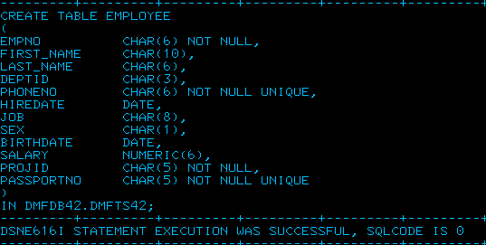
Create table employee without PK

Slide 16


Altering a table to add PK

Slide 17
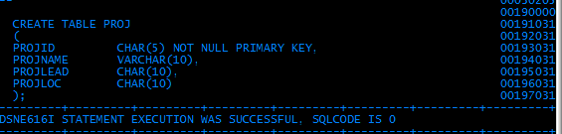

Table with PK

Slide 18
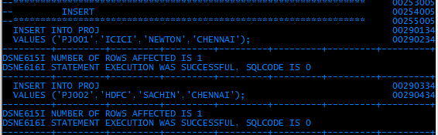
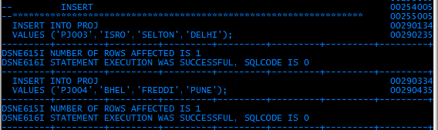

Slide 19
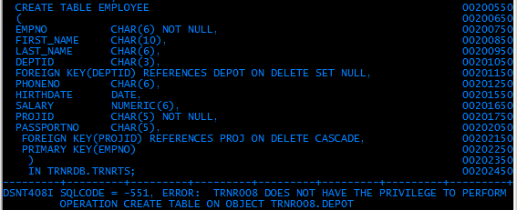
Table with foreign key that references a table which does not exist.
There is no table DEPOT

Slide 20
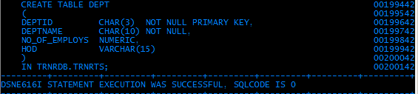
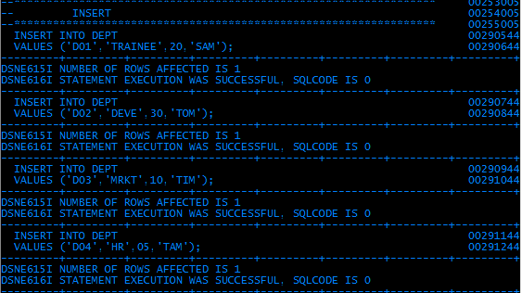

Slide 21
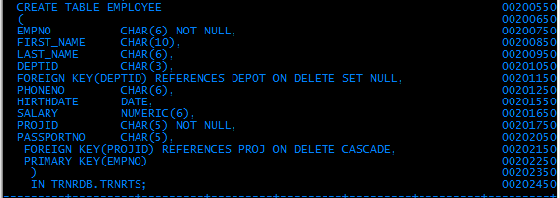

Creating a table with proper parent table

Slide 22

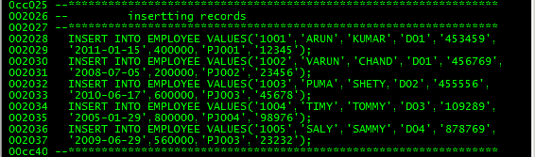
There is no projid PJ006 in PROJ table.There is only PJ001 to PJ004
INSERTing values into a child table when the value is not in parent table

Slide 23
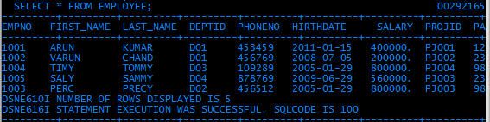
Content of the tables EMPLOYEE

Slide 24
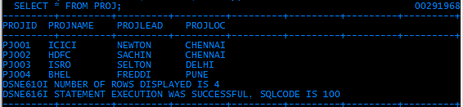
Content of the tables PROJ

Slide 25
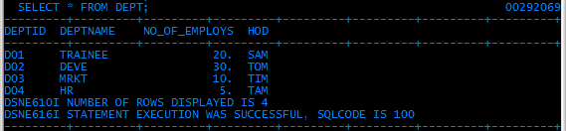
Content of the tables DEPT

Slide 26
2.DATA MANIPULATION LANGUAGE (DML)
1. Insert
2. Update
3. Delete
Condtional usage of the above commands associates WHERE Clause.
Notes:
Through Last lesson, We know how to work with the table structure. Now will see how to work with the table data.
DML is DATA MANIPULATION LANGUAGE which helps us to work with the table data.
Will see more detailed in this lesson.

Slide 27
1.INSERT
Inserting New Record into a Table
2.DATA MANIPULATION LANGUAGE (DML)
Inserts values to the columns.
The values are positional, so that the first value goes in to the first column of the table.
Syntax:
INSERT INTO <Table_name>
Values ( col1_value, col2,Value,…………)
INSERT INTO DEPT
VALUES(‘D001’,’Finance’);
Notes:
First will see about INSERT Command.
Insert is the command which is used for inserting the new records into the table.
The general syntax is
INSERT INTO <Table_name>
Values ( col1_value, col2,Value,…………)
Insert is the command which identifies the insert operation.
Next INTO parameter identifies that which table to be inserted. So the into parameter is followed by the table name which to be inserted.
Then Values clause contains the values that to be inserted into the specified table.
While giving the values in VALUES clause for fields , it should be given in the same sequence order as in the table.
Also we should remember that, except numeric data all other data should be in single quotes.
Now will see an example,
Consider a table dept which contains 2 fields that is deptno of char data type and deptname of varchar data type.
Now insert a record of deptno as D001 and Name as Finance. The syntax is
INSERT INTO DEPT
VALUES(‘D001’,’Finance’);
While inserting the records we should think about primary key ,foreign key and other constrains, if its violated, the command won’t execute, and error will be displayed by respective SQLCODE. Will see more on this in end of this seesion.

Slide 28
Inserting New Record into a Table
2.DATA MANIPULATION LANGUAGE (DML)
While inserting the records, Sequence of the values can vary corresponding to column list mentioned in the SQL rather than as in table.
Syntax:
INSERT INTO <Table_name> (Col3,clo1,…..)
Values ( col3_value, col1_Value,…………)
INSERT INTO DEPT( Dept_name, Dept_No )
VALUES(’Finance’,’D001’);
Notes:
Fine we saw how to insert a new record into the table thro’ INSERT command.
Suppose we can to alter the sequence of the table field while inserting the values. Is it possible? Yes its possible. We can alter the sequence of the fields in the INSERT command by slight modification of pervious INSERT Statement.
That is, along with table name in INTO clause we specify the order of fields, that the values to be inserted.
For example, with reference to the previous slide, we change the order of the columnas first dept_name and then dept_no. then the syntax will be INSERT INTO DEPT( Dept_name, Dept_No )
VALUES(’Finance’,’D001’);
Fine we changed the order in input syntax. What happen in the table, whether the column sequence will get changed.
No, then column sequence won’t change. Though the value order is changed, it will insert into the table in respective column only.
Ok cleared.

Slide 29
Inserting Null values into the Table.
2.DATA MANIPULATION LANGUAGE (DML)
NULL values can be inserted into the columns by NULL key word and even can insert with the name of the column.
Syntax to insert NULL value in column 2:
INSERT INTO <Table_name> (col3,col1,col4)
Values ( col3_value, col1_Value,col4_val)
INSERT INTO <Table_name>
Values ( col1_value,NULL,col3_Value, col4_val)
TABLE1
TABLE2
To copy all records from table1 to table2
Insert into table2 values(select * from table1);
Notes:
Now will see NULL value insertion.
Already we have seen about NULL, missing value or Unknown value.
How can we pass this missing value or Unknown value?
We can pass NULL value in two ways.
One is using column name in INSERT query as in previous slide. That is
In pervious slide, we specify the column name in INTO parameter of INSERT syntax.
In case if any column name is omitted in INTO clause, then that column won’t insert any values from VALUES clause, instead it allows NULL value to that column.
Example ,
INSERT INTO dept (Dept_no)
Values (‘D001’);
Here in the above example, it will take the value D001 for dept_no but there is no value for dept_name it won’t show any error message. It consider that NULL value in dept_name.
Second way for NULL value insertion is using NULL keyword.
In normal insert query, where ever we want to pass NULL value there we can use the key word NULL. Which specify that the column in that position will accept null value.
Fine now we know how to pass NULL values to the column.
While passing the NULL values, we have to be sure that the column with accepts NULL value should not be the column with NULL constrain as NOT NULL. If so, the error message will be displayed.

Slide 30
2.UPDATE
Modifying Value (s) of a column
2.DML
UPDATE command will modify the values in the existing column.
Syntax:
UPDATE <table name>
SET <column name>=value/expression
Update employee
set salary = salary + salary * 0.6
Update employee
set mobile_no = ‘9841231231’
Note:
This statement will update the values (mobile numbers) of all records in the table.
Notes:
Well we know how to insert new records into a table.
Next we will see How to modify the values of the existing records?.
UPDATE is the command which will do this job.
Syntax is
UPDATE <table name>
SET <column name>=value/expression
UPDATE key word follows the table name which to be processed.
Then SET parameter identified the column which to be modified and then value for modification thro’ assigning operator.
The value that to be modified can be either the value or even it can be a expression with some column of the table.
For example in Employee table the salary has to be incremented 60% of existing salary. so the query will be
UPDATE employee
set salary = salary + salary * 0.6
Will see another example,
Update employee
set mobile_no = ‘9841231231’
This will modify the existing mobile_no with 9841231231.
Ok fine this will update the value for the column specified. Which row will get effected.
This query will update on all rows of the table.
So if I want to update on specific rows alone then we use where clause with UPDATE, which will see I detail later.

Slide 31
MODIFYING MORE THAN ONE column VALUE IN A ROW
2.DML
UPDATE <table name>
SET col1 = value/expression,
col2 = value/expression ;
UPDATE EMP
SET SALARY = salary + salary * 0.6 ,
Mobile_no = ‘9841231231’;
Notes:
we updated two column values of same table with two different queries.
Is it possible to update more than one column of same table with single update query,
Yes, we can.
this can be done thro; set clause, In set clause of UPDATE query , columns to be updated can be specified one by one with separated comma.
For example
UPDATE EMP
SET SALARY = salary + salary * 0.6 ,
Mobile_no = ‘9841231231’;

Slide 32

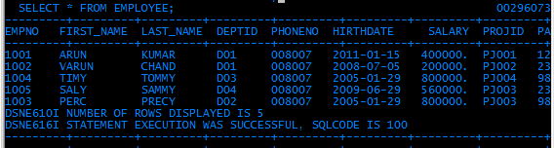
Update Screen Shot
2.DML
All the telephone numbers are set to 008007

Slide 33
3.DELETE
Deleting the Records in a table.
2.DML
DELETE command will delete the records in the table.
Syntax
DELETE from <table_ name>
Example
Delete from employee
This statement will remove all the records from the table employee.
Notes:
Next we go for DELETE statement.
DELETE command is for removing the records from the table permanently.
Once the records are deleted, that can’t be get back.
Syntax for DELETE is
DELETE from Table-name.
For Example
DELETE from EMPLOYEE
This will delete all the records in the employee table.

Slide 34
Retrieval of ALL Columns
2.DQL
1. SELECT
SELECTting all the columns from the table.
Syntax:
Select * from <tablename>;
→ all the columns.
where
Example:
Select * from Employee;
Notes:
In order to retrieve all the columns of the table we have to use the following syntax:
SELECT * FROM TABLENAME;
TABLENAME should be the name of the Existing table.
Example is: SELECT * FROM EMPLOYEE;
The above query will fetch all the columns of the Employee table.

Slide 35
2.DML
4. SELECT

Slide 36
2.DML
4. SELECT
SELECTing SELECTIVE columns from the table.
Syntax:
Select col1, col2,col3 from <table name>
Example:
Select
emp_code,
emp_name,
salary
from
employee ;
Notes:
Now we are going to Discuss about How to retrieve only specific columns from the table using SELECT statement?
The syntax is:
Select col1, col2,col3 from <table name>
Example is:
Suppose consider the Employee table is having 6 fields and we want to retrieve only 3 specific columns from that table.
For that we can write the query as given below:
Select emp_code, emp_name, salary from employee ;
In this example, emp_code, emp_name, & salary field will be retrieved from the Employee table and displayed

Slide 37
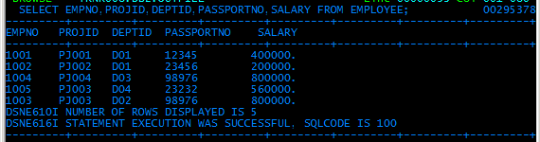
SELECT EMPNO,PROJID,DEPTID,PASSPORTNO,
SALARY from EMPLOYEE
2.DML
4. SELECT

Slide 38
THE “WHERE” CLAUSE

Slide 39
THE “WHERE” CLAUSE
The “where” clause can be given in any DML statement except INSERT statement.
That is Where clause comes along with Update, Delete and Select statement.
If Where clause is omitted in any statement, that operation will perform on all the records in the table.
Notes:
Well we saw where clause,
Where this where clause comes only with UPDATE statements?
No.
We can use this where clause in all the DML statements except INSERT statements.
That is
This Where clause can be used along with UPDATE, DELETE and SELECT statements.
IF we omitted this where clause in the statement, the specified DML operation will perform on all the existing records.

Slide 40
Various condition in Where clause
THE “WHERE” CLAUSE
Condition:
Relational Operators.
Logical Operators.
“Between” Operator
“IN” operator
“IS” operator
“Like” Operator.
Notes:
Next we will see the format for the conditions that given along where clause.
There are various condition formats.
Relational Operators
Logical Operators
Between Operators.
IN operators
IS operators
LIKE operators.

Slide 41
Relational operators.
THE “WHERE” CLAUSE
< Less than
> Greater than
= Equal to
<= Less than or Equal
>= Greater than or equal.
<> Not equal.
Notes:
First will see the Relational Operators in condition.
Relational operators are used for comparing the values along with the columns.
All 6 comparative operators can be used for the condition in Where clause.
Condition applied in where clause with relational Operators
< Less than
> Greater than
= Equal to
<= Less than or Equal
>= Greater than or equal.
<> Not equal.

Slide 42

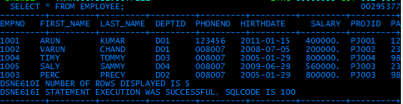
THE “WHERE” CLAUSE
Relational operators.

Slide 43
Logical operators.
THE “WHERE” CLAUSE
More than one Condition can be applied in where clause using logical Operators
AND
OR
NOT
Notes:
Next will see Logical Operator.
IF we have to process the records based on more than one condition, then we go for logical operators.
Logical Operators are AND , OR, NOT.
AND takes the chance to combine two condition, it performs the operation when both the conditions are true.
OR takes the chance to combine two condition, it performs the operation when any one of the conditions is true.
NOT is for negation ( negative conditions)
Will see the examples for these, next.

Slide 44
Logical operators.
THE “WHERE” CLAUSE
Example with Logical Operators.
1. UPDATE employee
set salary = salary + 5000
where dept_no= ‘D001’ AND desig =‘manager’
2. UPDATE employee
set salary = salary + 5000
where salary >= 25000 OR desg=‘Supervisor’;
3.UPDATE employee
set salary = salary + 5000
where desig NOT = ‘Manger’ ;
Notes:
Example 1
Increment the salary by 5000 for the manager of dept ‘D001’.
Update employee
set salary = salary + 5000
where dept_no= ‘D001’ and desg =‘Manger’
Example 2:
Increment the salary by 5000 for employees who draws salary 25000 and more and also for all supervisors.
Update employee
set salary = salary + 5000
where salary >= 25000 or desg= ‘Supervisor’;
Increment the salary by 5000 for all employees other than manager.
Update employee
set salary = salary + 5000
where desig Not = ‘Manger’ ;

Slide 45
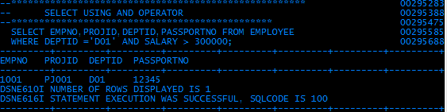
THE “WHERE” CLAUSE
Logical operators.

Slide 46
Between operator.
THE “WHERE” CLAUSE
To choose the list of employees whose salary is greater than equal to 10000 and less than equal to 15000 we use the following command
SELECT * from employee
Where salary >= 10000 AND salary <=15000
The above operation can be done with a single operator.
Between operator.
SELECT name,salary from employee
Where salary between 10000 and 15000
NOTE: both the boundary values will be included.
Notes:
Now will see about Between operator.
Before that, I will leave a query to you,
I want update the salary by 5000 for the employees who’s current salary is from 10000 to 15000.
So we know to use the logical operators for a range of values that is ,
Update employee salary= salary + 5000
Where salary >=10000 and salary <=15000
Here we are using 2 relational operators and one logical operators.
This can be simplified using only one operator “ BETWEEN”
So the above query will change as
Update employee salary= salary + 5000
Where salary between 10000 and 15000
When we use Between operators it will take the lower and upper boundary in consideration

Slide 47
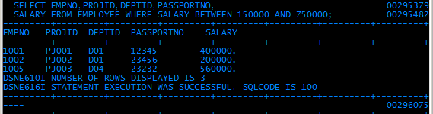
THE “WHERE” CLAUSE
Between operator.

Slide 48
THE “WHERE” CLAUSE
IN operator.
Gender char(01) check ( gender in(‘m’,’f’,’o’)
To choose from a list.
SELECT salary from employee
Where dept_no = ‘D001’ or
dept_no =‘D005’,or,
dept_no =’D003’,or,
dept_no =’D010’
Eg
: SELECT salary from employee
Where dept_no in ( ‘D001’, ‘D005’,’D003’,’D010’)
Notes:
Next will see about IN Operators,
IN operators is to select the records that are present in the list which has been specified in the bracket.
For Example:
Update employee set salary =salary + 5000
Where dept_no in ( ‘D001’,‘D005’,’D003’,’D010’);
In above example, the records who’s dept_no are D001,D005,D003,D010 are updated, where as others will remains same.

Slide 49
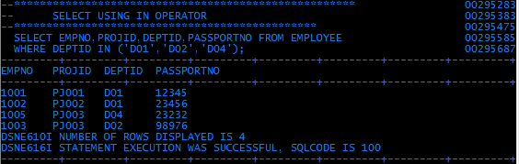
THE “WHERE” CLAUSE
IN operator.

Slide 50
THE “WHERE” CLAUSE
IS operator.
‘IS’ -the operator which is used along where clause to choose the records for operation whose values would be NULL or NOT NULL
update Employee set salary = salary + 5000
where dept_no is NULL.
update Employee set salary = salary + 3000
where dept_no is NOT NULL.
Notes:
Now will see about IS operators.
How to select the records based on the NULL values.
NULL is an unknown value, so it can’t be used in relational operator. Then how?
For that we go with IS operators.
Update Employee set salary = salary + 5000
where dept_no is NULL.
The above example will process the records who’s dept_no contains NULL values. Rest will remains same.
Update Employee set salary = salary + 3000
where dept_no is NOT NULL.
This example will process the records who’s dept_no column contains some value other than NULL value.

Slide 51
THE “WHERE” CLAUSE
LIKE operator.
E.g. SELECT CUST_NO, CUST_NAME, CUST_ADDR
FROM CUSTOMER
WHERE CUST_ID like/not like ‘425%’
WILD CARD charectors
‘_’ for a single char ;
‘%’ for a string of chars
‘\’ - escape char; if precedes ‘_’ or ‘%’ overrides
their meaning.
Notes:
Next will see, How to retrieve the records based on some text pattern in the value.
Now I want to process all the records who’s name ends with ‘son’(Example Johnson, Thomson, Nelson, Richardson………)
How to write a query?
This can be done thro’ LIKE operator.
First will see about LIKE operator which can be used for character values. This Operators filters the matched records based on the pattern given in the query.
For Constructing the pattern , we use 2 wild cards.
%(Percentage symbol) : This symbol say that occurrence of zero or many characters.
_(Underscore) : This symbol say that Occurrence of one and only.
Now we go back to our query,
We want to write a pattern for a string ends with son.
‘%son’
Before the sub string son there can be any no of characters. so pattern is %son.
Now the query will be
Update employee set mobile_no=‘9841724907’ where emp_name like ‘%son’.
Now will see some more patterns.
To Select a string with ‘abc’ as substring , pattern will be ‘%abc%
For retrieving the record of string who’s 3rd and 5th character is x and y is ‘__x_y%’
For String with starting later ‘a’ is ‘a%’.
Fine we say some patterns, this will help us to construct the pattern as our need.

Slide 52
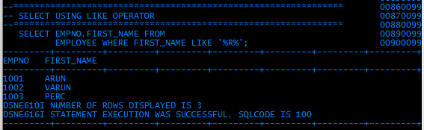
THE “WHERE” CLAUSE
LIKE operator.
Notes:
Next will see, How to retrieve the records based on some text pattern in the value.
Now I want to process all the records who’s name ends with ‘son’(Example Johnson, Thomson, Nelson, Richardson………)
How to write a query?
This can be done thro’ LIKE operator.
First will see about LIKE operator which can be used for character values. This Operators filters the matched records based on the pattern given in the query.
For Constructing the pattern , we use 2 wild cards.
%(Percentage symbol) : This symbol say that occurrence of zero or many characters.
_(Underscore) : This symbol say that Occurrence of one and only.
Now we go back to our query,
We want to write a pattern for a string ends with son.
‘%son’
Before the sub string son there can be any no of characters. so pattern is %son.
Now the query will be
Update employee set mobile_no=‘9841724907’ where emp_name like ‘%son’.
Now will see some more patterns.
To Select a string with ‘abc’ as substring , pattern will be ‘%abc%
For retrieving the record of string who’s 3rd and 5th character is x and y is ‘__x_y%’
For String with starting later ‘a’ is ‘a%’.
Fine we say some patterns, this will help us to construct the pattern as our need.

Slide 53
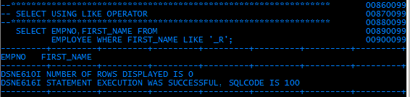
THE “WHERE” CLAUSE
LIKE operator.

Slide 54
4. SELECT - revisited
SELECT is the statement that retrieves the records from the table.
Overall Syntax:
SELECT <column_list> FROM <table_name>
{WHERE <search_condition> } - optional
{GROUP BY <grouping cols> } - optional
{HAVING <group search> } - optional
{ORDER BY <sort_order> } - optional
Notes:
Generally SELECT statement is used to retrieve the columns (fields) from the table. i.e., used to retrieve the records from the table.
The Syntax is:
SELECT <column_list> FROM <table_name>
{WHERE <search_condition> } - optional
{GROUP BY <grouping cols> } - optional
{HAVING <group search> } - optional
{ORDER BY <sort_order> } - optional
In the above syntax:
<column_list> indicates the columns to be retrieved from the table.
<table_name> indicate the name of the table from where the data are going to be retrieved.
<Where> indicates the searching condition i.e., based on the condition specified the data is retrieved.
{Group by <grouping cols>} indicates grouping the records by using the columns.
{Having <group search>} indicates the search condition when grouping the records using Group by clause.
{Order by <sort_order>} indicates how to arrange the data either in ascending OR descending order.
We will discuss more about the optional clauses of the SELECT statement & its examples in detail later.

Slide 55
SELECT – ORDER BY clause
Arranging the Retrieved Data
Data displayed in SELECT clause is normally not arranged in any sequence.
If rows need to be sorted, ORDER BY clause needs to be added to it.
        SELECT column names
        FROM Tablename
        ORDER BY columnname Sequence;

Slide 56
SELECT – ORDER BY clause
Arranging the Retrieved Data
        SELECT EMPNO ,SALARY
        FROM EMP
        ORDER BY SALARY;
By default it will display in the ascending order of the salary
        SELECT EMPNO ,SALARY
        FROM EMP
        ORDER BY SALARY desc;
- Now it will display in the descending order of the salary
Notes:
Next we are going to discuss about how the data are arranged while retrieving?
To arrange the data either in ascending order OR descending order we can use ORDER BY clause.
ORDER BY clause is used to specify the order in which the rows are retrieved.
Example 1:
SELECT EMPNO ,SALARY FROM EMP ORDER BY SALARY;
By default it will display in the ascending order of the salary
Example 2:
SELECT EMPNO ,SALARY FROM EMP ORDER BY SALARY desc;
- Now it will display in the descending order of the salary

Slide 57
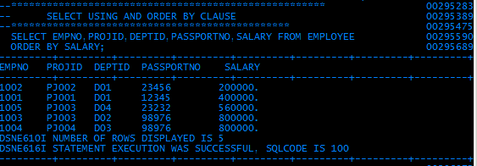
SELECT – ORDER BY clause
Arranging the Retrieved Data - ASCENDING

Slide 58
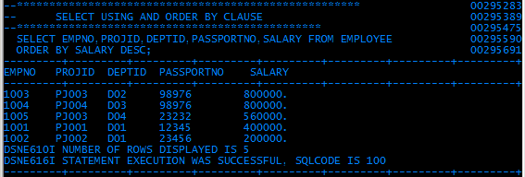
SELECT – ORDER BY clause
Arranging the Retrieved Data - DESCENDING

Slide 59
SELECT – ORDER BY clause
Arranging the Retrieved Data
based on More than one column
        SELECT EMPNO, SALARY,DEPT_NO
        FROM EMP
        ORDER BY DEPT_NO Desc , SALARY Asc ;
Notes:
In this example the data are going to be arranged by two columns. i.e., arranging the data by DEPTNO in descending order as well as by the SALARY field in ascending order.

Slide 60
SELECT – GROUP BY clause
Used to divide the rows in a table in to smaller groups.
Group functions can then be used to return summary information for each group.
SELECT <COLUMNS>
FROM TABLENAME
GROUP BY COLUMN;

Slide 61
SELECT – GROUP BY clause
The GROUP BY clause can also be used to get result for groups within groups.
The following command would display total salary paid for each department.
SELECT deptno, SUM(Salary)
FROM emp
GROUP BY Deptno;
Aggregate functions will be discussed in a short while

Slide 62
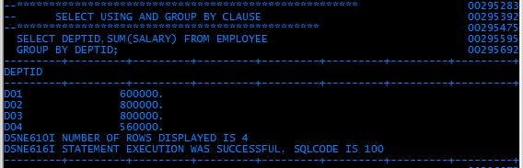
SELECT – GROUP BY clause
Note that the column name did not appear – we will discuss later

Slide 63
SELECT – GROUP BY – HAVING clause
To Apply the condition on grouped record for retrieval can be done through HAVING Clause.
Syntax:
SELECT c1,c2,c3….
FROM tablename
GROUP BY c1
HAVING condition;
Example :
SELECT deptno, SUM(Salary) FROM emp GROUP BY Deptno
Having sum(salary) >100000;

Slide 64
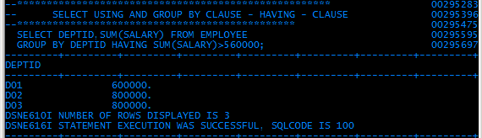
SELECT – GROUP BY – HAVING clause
Note that the column name did not appear – will discuss later
Notes:
Now we are going to discuss about HAVING clause.
We cannot use Aggregate functions in ‘WHERE’ clause instead HAVING clause should be specified.
Use HAVING clause to specify a search condition that each retrieved group must satisfy.
Syntax is:
SELECT c1,c2,c3… FROM tablename GROUP BY c1 HAVING condition;
Where C1,C2,C3 are the name of the columns to be retrieved and C1 after the GROUP BY clause indicates the column name by which the rows grouped.
Example is:
SELECT deptno, SUM(Salary) FROM emp GROUP BY Deptno Having sum(salary) >100000;
When the above query is executed it will display total salary paid for each department for only those departments where the total salary is greater than 1lakh.

Slide 65
SELECT–GROUP BY–HAVING-WHERE clause
To Apply the condition on grouped record for retrieval can be done through HAVING Clause.
Example :
SELECT deptno, SUM(Salary)
FROM emp
GROUP BY Deptno
Having sum(salary) >100000
where emp_status=‘Permanent’;
Notes:
Example 2:
SELECT deptno, SUM(Salary) FROM emp GROUP BY Deptno Having sum(salary) >100000 where emp_status=‘Permanent’;
When the above query is executed it will display total salary paid for each department for only those departments where the total salary is greater than 1lakh and status of the employee should be permanent.

Slide 66
FETCH CLAUSE
To retrieve set of records by specifying its sequence from a table, FETCH clause can be used.
SYNTAX:
SELECT * FROM EMP FETCH FIRST 5 ROWS ONLY.
The above SQL query will retrieve the first five records from the table EMP.
There is no ”LAST” option.

Slide 67
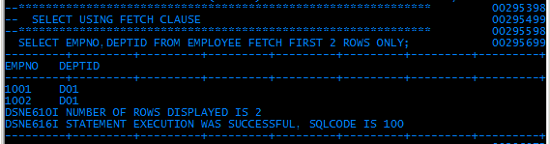
FETCH CLAUSE

Slide 68
SUBSTITUTION OF NULL VALUES
-COALESCE
When a value of a column is NULL the user can
assign a value for that particular row and column using COALESCE clause in the SQL statement.
The user assigning value need not be of the same data type as that of the column.

Slide 69
SUBSTITUTION OF NULL VALUES
-COALESCE
SELECT DEPTNAME,
COALESCE (MGRNO, 'UNKNOWN')
AS MANAGER
FROM DEPARTMENT
ORDER BY DEPTNAME;
When the value for MGRNO is NULL, “UNKNOWN” will replace it.
DEPTNAME MANAGER
ADMINISTRATION SYSTEMS 000070
DEVELOPMENT CENTER UNKNOWN
INFORMATION CENTER 000030
MANUFACTURING SYSTEMS 000060

Slide 70
FUNCTIONS
Types of Functions are :
  Arithmetic Functions
  Aggregate (Column) Function
  Scalar Function
  NOTE: The column name, on which the function is applied, will not appear on the output. But, ALIAS name can be used. It will be discussed in detail later.
Notes:
Next topic is about types of functions.
There are two types of functions:
i) Aggregate (or) Column function ii) Scalar function.
Let’s discuss one by one in detail.

Slide 71
ARITHMETIC FUNCTIONS
An arithmetic expression is a combination of one or more values,operators and functions which evaluate to a value.
May contain column names, constant numeric values and the arithmetic operators.
+ add, - subtract, * multiply , / divide
E.G.
Select EMPNAME,SALARY*1.1/100
From EMP
Notes:
Now we are going to discuss about how arithmetic expressions are involved in SELECT statement?
What is an Arithmetic Expression?
An arithmetic expression is a combination of one or more values, operators and functions which evaluate to a value.
May contain column names, constant numeric values and the arithmetic operators.
The arithmetic symbols that can be used are:
+ add, - subtract, * multiply , / divide
Example is:
Select EMPNAME,SALARY*1.1/100 From Employee;
When the above query is executed, it will display the EMPNAME & SALARY field from the Employee table where the salary will be multiplied by 1.1 and the result will be divided by 100. The change in the salary field is applicable to the Result set only and it will not affect the base table.

Slide 72
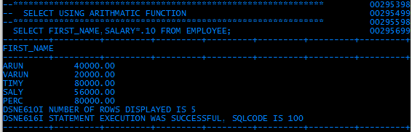
ARITHMETIC FUNCTIONS
MULTIPLICATION
Note that the column name did not appear – will discuss later
Notes:
Now we are going to discuss about how arithmetic expressions are involved in SELECT statement?
What is an Arithmetic Expression?
An arithmetic expression is a combination of one or more values, operators and functions which evaluate to a value.
May contain column names, constant numeric values and the arithmetic operators.
The arithmetic symbols that can be used are:
+ add, - subtract, * multiply , / divide
Example is:
Select EMPNAME,SALARY*1.1/100 From Employee;
When the above query is executed, it will display the EMPNAME & SALARY field from the Employee table where the salary will be multiplied by 1.1 and the result will be divided by 100. The change in the salary field is applicable to the Result set only and it will not affect the base table.

Slide 73
ARITHMETIC WITH NULL VALUES
- COALESCE
SELECT EMPNO, SALARY, COMM,
SALARY + COMM AS "TOTAL INCOME"
FROM EMPLOYEE;
EMPNO SALARY COMM TOTAL INCOME
000210 18270.00 1462.00 19732.00
000260 17250.00 - -
000290 15340.00 1227.00 16567.00
000300 17750.00 - -
... ... ... ...

Slide 74
ARITHMETIC WITH NULL VALUES
SELECT EMPNO, SALARY, COMM,
SALARY +COALESCE (COMM, 0)
AS "TOTAL INCOME"
FROM EMPLOYEE
EMPNO SALARY COMM TOTAL INCOME
000210 18270.00 1462.00 19732.00
000260 17250.00 - 17250.00
000290 15340.00 1227.00 16567.00
000300 17750.00 - 17750.00

Slide 75
AGGREGATE (COLUMN) FUNCTIONS
Compute from a group of rows aggregate value for a specified column's
AVG, COUNT, MAX, MIN, SUM
  SELECT AVG(SALARY) A00_AVGSAL
  FROM DSN0010.EMP
  WHERE WORKDEPT = 'A00'
Try the others..
Notes:
First function is Aggregate function.
An Aggregate function is one which takes group of values as input and returns a single value as an output.
Some of the Aggregate functions are: AVG, COUNT, MAX, MIN, SUM.
i) AVG : is used to calculate the average of a column in the database.
ii) SUM : is used to find out the sum of the values of a column.
iii) MIN : is used to find the minimum value of a column.
iv) MAX : is used to find out the maximum value of a column.
v) COUNT(*) : is used to find out the number of rows in the table.
Let’s us discuss some examples:
i) Select AVG(SALARY) from Employee;
The above query will find out the average value of the salary field column of the Employee table.
ii) Select MIN(SALARY) from Employee;
The above query will find out the minimum value of the salary field column
iii) Select MAX(SALARY) from Employee;
The above query will find out the maximum value of the salary field column.
iv) Select SUM(SALARY) from Employee;
The above query will find out the sum of all values of the salary field column.
v) Select COUNT(*) from Employee;
The above query will find out the number of rows of the Employee table.

Slide 76
AGGREGATE (COLUMN) FUNCTIONS
Note that the column name did not appear – will discuss later

Slide 77
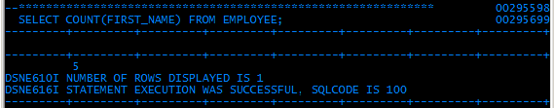
AGGREGATE (COLUMN) FUNCTIONS
COUNT

Slide 78
SCALAR FUNCTIONS
Are applied to a column or expression and operate on a single value.
CHAR, DATE, DAY(S), DECIMAL, DIGITS, FLOAT, HEX, HOUR, INTEGER, LENGTH, MICROSECOND, MINUTE, MONTH, SECOND, SUBSTR, TIME, TIMESTAMP, VALUE, YEAR
  SELECT SUBSTR(CUST_NAME,1,7)
  FROM DSN0010.CUSTOMER
Notes:
The next function is Scalar function.
What is Scalar function?
A Scalar function receives one value as an input and produces one value as an output. If the scalar function has several arguments, each argument results in a single value.
There are several scalar functions. Let’s discuss some of them:
1) CHAR - a string representation of its first argument.
Ex: CHAR(HIREDATE)
2) DATE - a date derived from its argument.
Ex: DATE(‘1998-03-02’)
3) DAY - returns the day part of its argument.
Ex: DAY(DATE1 – DATE2)
4) DAYS - An integer representation of its argument
Ex: DAYS(‘1988-12-16’) – DAYS(‘1991-11-02’)+1
5) DECIMAL - A decimal representation of its first argument.
Ex: DECIMAL(AVG(SALARY),8,2)
6) DIGITS - A character string representation of its argument.
Ex: DIGITS(COLUMNX)
7) FLOAT - Floating-point representation of its argument.
Ex: FLOAT(SALARY)/COMM
8) HEX - Hexadecimal representation of its argument.
Ex: HEX(BCHARCOL)
9) HOUR - The hour part of its argument.
Ex: HOUR(TIMECOL)>12
10) INTEGER – returns the integer representation of its argument.
Ex: INTEGER(AVG(SALARY)+0.5)
11) LENGTH - Length of its argument.
Ex: LENGTH(ADDRESS)
12) MICROSECOND - returns the microsecond part of its argument.
Ex: MICROSECOND(TIMECOL) > 12
13) MINUTE - returns the minute part of its argument.
Ex: MINUTE(TIMECOL) >59
14) MONTH - returns the month part of its argument.
EX: MONTH(BIRTHDATE)=16
15) SECOND – returns the seconds part of its argument.
EX: SECOND(TIMECOL)>59
16) SUBSTR – returns a substring of a string.
EX: SUBSTR(NAME,1,3)
17) TIME - Time derived from its argument.
Ex: TIME(TSTMPCOL) < ’12:00:00’
18) TIMESTAMP – returns a timestamp derived from its argument or arguments.
Ex: TIMESTAMP(DATECOL,TIMECOL)
19) VALUE - returns the first argument that is not NULL.
Ex: VALUE(SMALLINT1, 100) + SMALLINT2 > 1000
20) YEAR - returns the year part of its argument.
Ex: YEAR(BIRTHDATE) = 1981

Slide 79
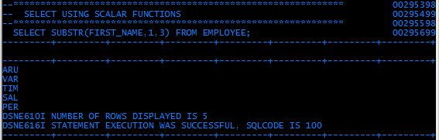
SCALAR FUNCTIONS - SUBSTR
SUBSTR
Note that the column name did not appear – will discuss later
Notes:
The next function is Scalar function.
What is Scalar function?
A Scalar function receives one value as an input and produces one value as an output. If the scalar function has several arguments, each argument results in a single value.
There are several scalar functions. Let’s discuss some of them:
1) CHAR - a string representation of its first argument.
Ex: CHAR(HIREDATE)
2) DATE - a date derived from its argument.
Ex: DATE(‘1998-03-02’)
3) DAY - returns the day part of its argument.
Ex: DAY(DATE1 – DATE2)
4) DAYS - An integer representation of its argument
Ex: DAYS(‘1988-12-16’) – DAYS(‘1991-11-02’)+1
5) DECIMAL - A decimal representation of its first argument.
Ex: DECIMAL(AVG(SALARY),8,2)
6) DIGITS - A character string representation of its argument.
Ex: DIGITS(COLUMNX)
7) FLOAT - Floating-point representation of its argument.
Ex: FLOAT(SALARY)/COMM
8) HEX - Hexadecimal representation of its argument.
Ex: HEX(BCHARCOL)
9) HOUR - The hour part of its argument.
Ex: HOUR(TIMECOL)>12
10) INTEGER – returns the integer representation of its argument.
Ex: INTEGER(AVG(SALARY)+0.5)
11) LENGTH - Length of its argument.
Ex: LENGTH(ADDRESS)
12) MICROSECOND - returns the microsecond part of its argument.
Ex: MICROSECOND(TIMECOL) > 12
13) MINUTE - returns the minute part of its argument.
Ex: MINUTE(TIMECOL) >59
14) MONTH - returns the month part of its argument.
EX: MONTH(BIRTHDATE)=16
15) SECOND – returns the seconds part of its argument.
EX: SECOND(TIMECOL)>59
16) SUBSTR – returns a substring of a string.
EX: SUBSTR(NAME,1,3)
17) TIME - Time derived from its argument.
Ex: TIME(TSTMPCOL) < ’12:00:00’
18) TIMESTAMP – returns a timestamp derived from its argument or arguments.
Ex: TIMESTAMP(DATECOL,TIMECOL)
19) VALUE - returns the first argument that is not NULL.
Ex: VALUE(SMALLINT1, 100) + SMALLINT2 > 1000
20) YEAR - returns the year part of its argument.
Ex: YEAR(BIRTHDATE) = 1981

Slide 80
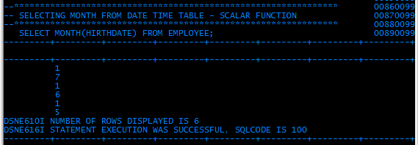
SCALAR FUNCTIONS - MONTH

Slide 81
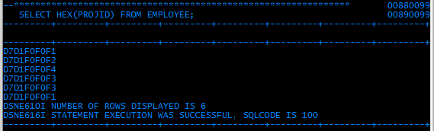
SCALAR FUNCTIONS - HEX

Slide 82
ELIMINATION OF DUPLICATION
To avoid duplication of entries in a SELECT output, use the DISTINCT clause.
Example :
SELECT DISTINCT DEPTNO FROM EMP;
Notes:
Now Let’s us learn how to eliminate the duplicate entries of a table in the resultset?
Suppose consider there are 100 employee records in the EMPLOYEE table. In that 25 employees belongs to the department number D001, another 25 employees belongs to the department number D002, as well as another 25 employees belongs to the department number D003 and the remaining 25 employees belongs to the department number D004.So there will be duplicate values in the filed Deptno.
So how will you eliminate the duplicate values? The solution is:
In order avoid the duplicate entries in the resultset we can use DISTINCT clause in the SELECT statement.
Example is:
SELECT DISTINCT DEPTNO FROM EMPLOYEE;
The output of the above query is, the duplicate values in the DEPTNO field will be eliminated and only one occurrence of the value will be displayed.

Slide 83
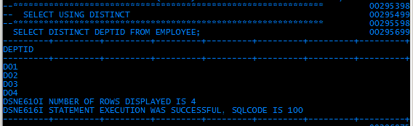
ELIMINATION OF DUPLICATION

